Slide 1
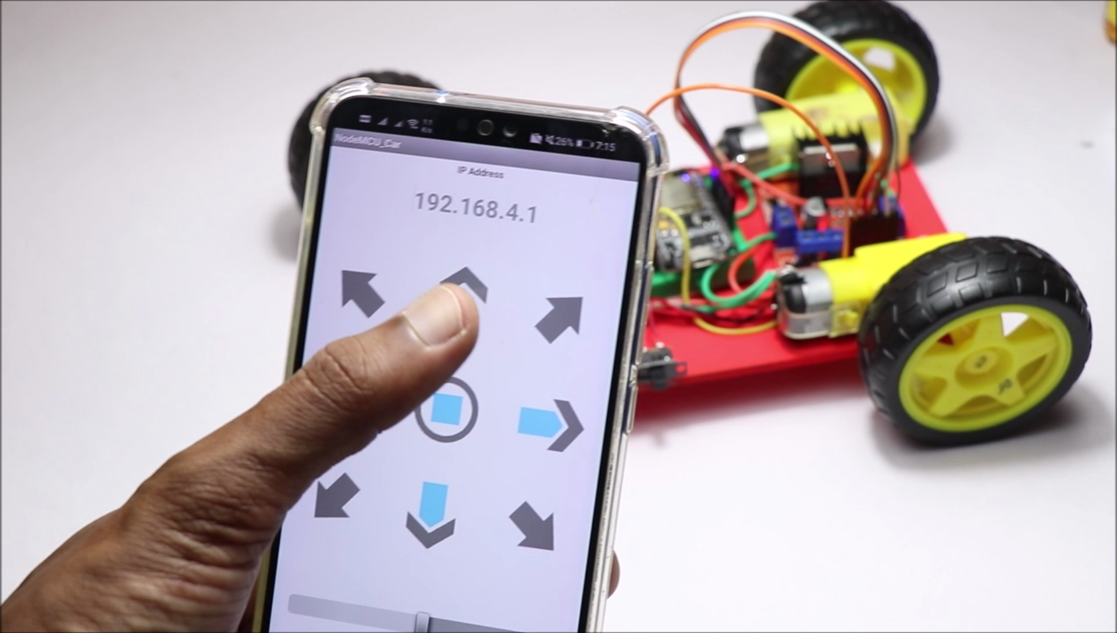
WiFi Controlled Car

Slide 2
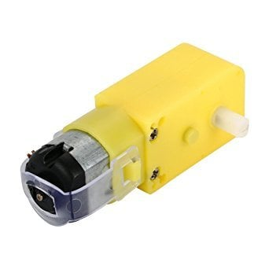
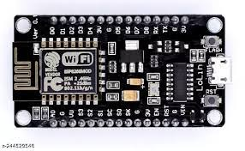
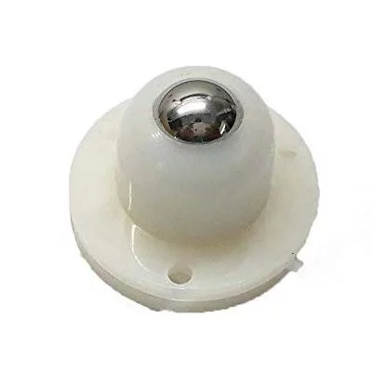
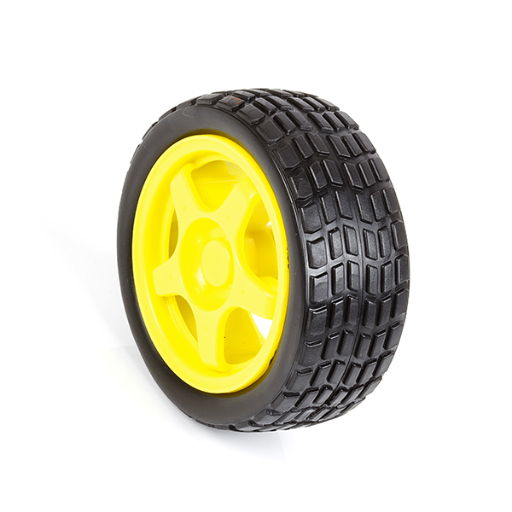
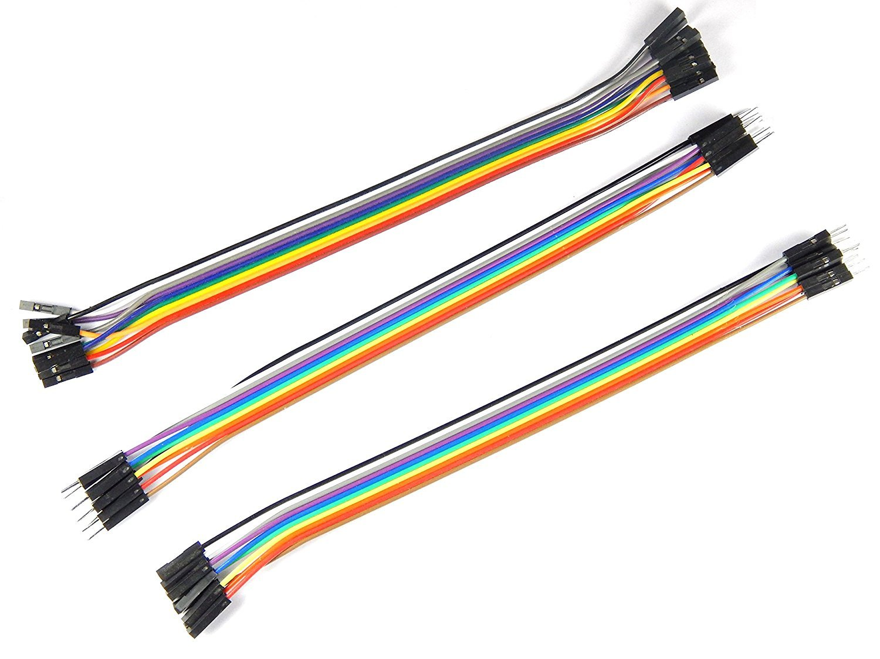
Components
Chasis
Motors
Wheels
Caster Wheel
L293D Motor Driver
Node MCU Board
Jumper Cables
Usb Cable

Slide 3



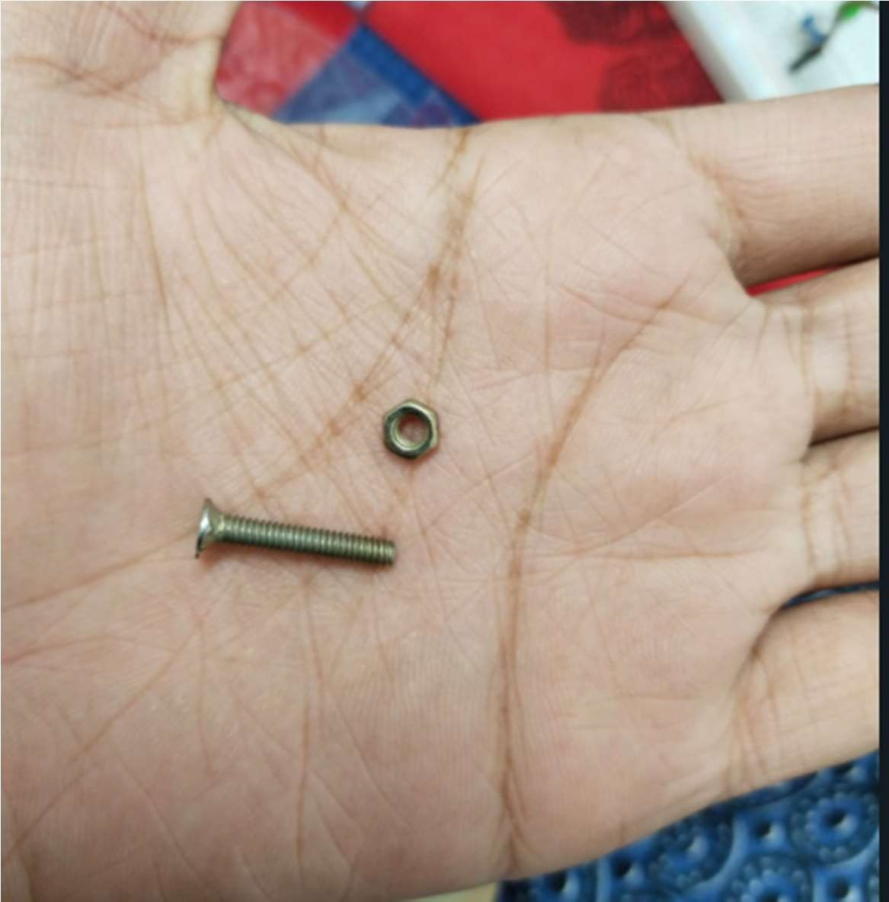
Step 1 : Take out Golden Nut and bolt
Take 3 Long Golden colour Nut and Blot

Slide 4

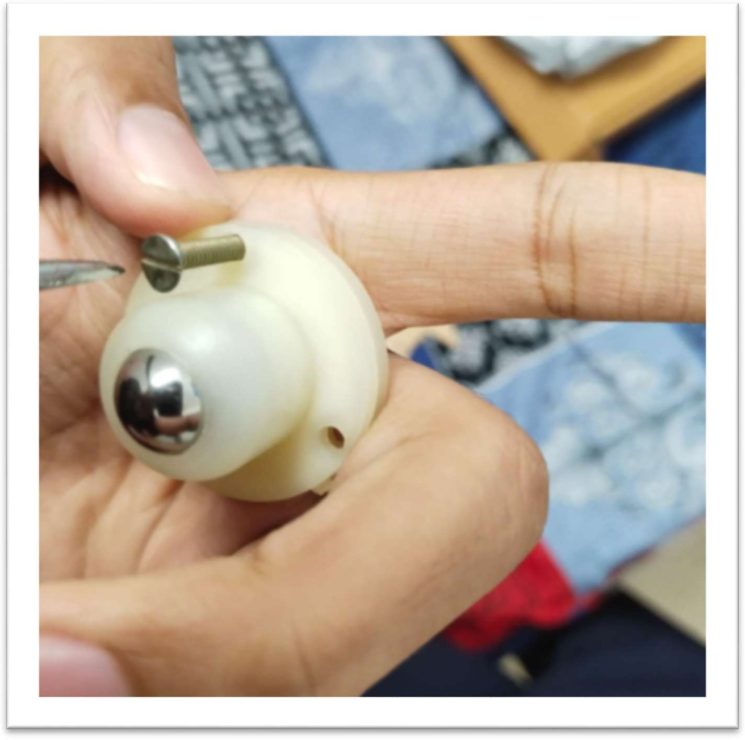
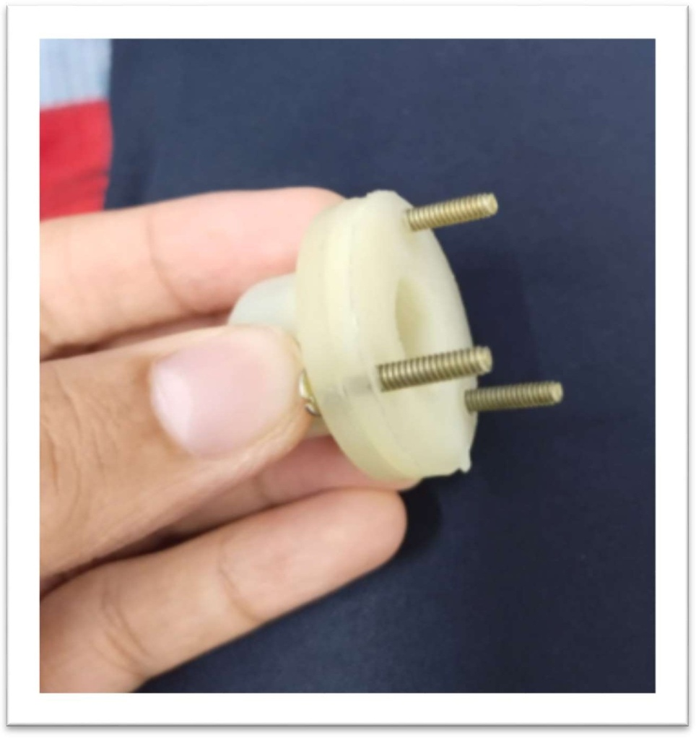
Step 2 :Insert Blots as shown below

Slide 5

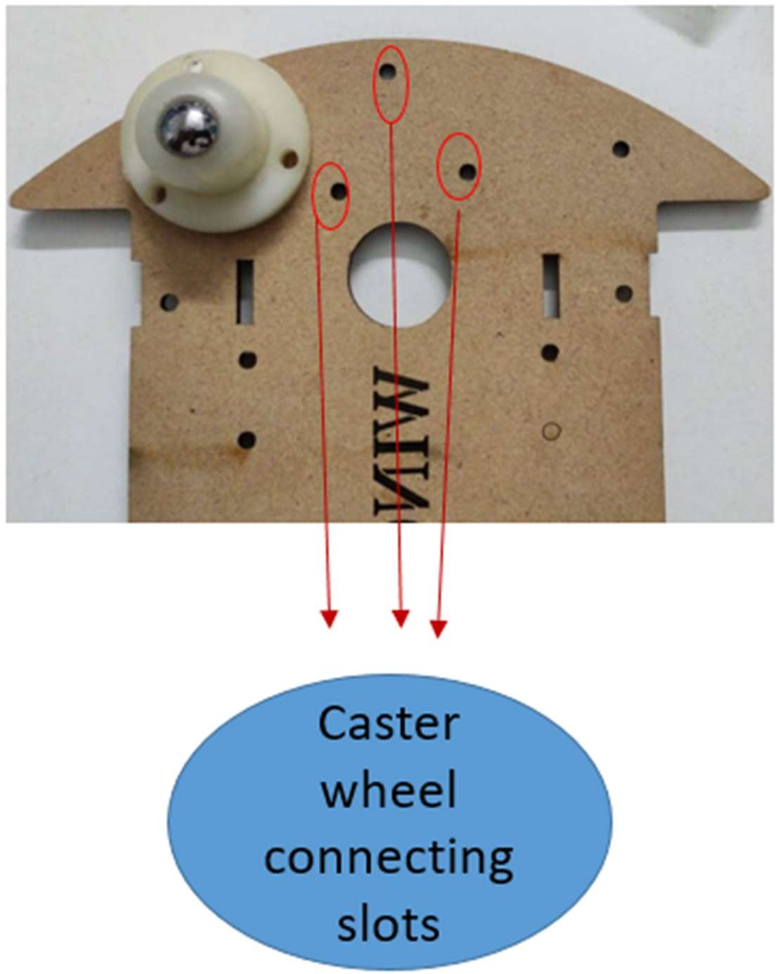
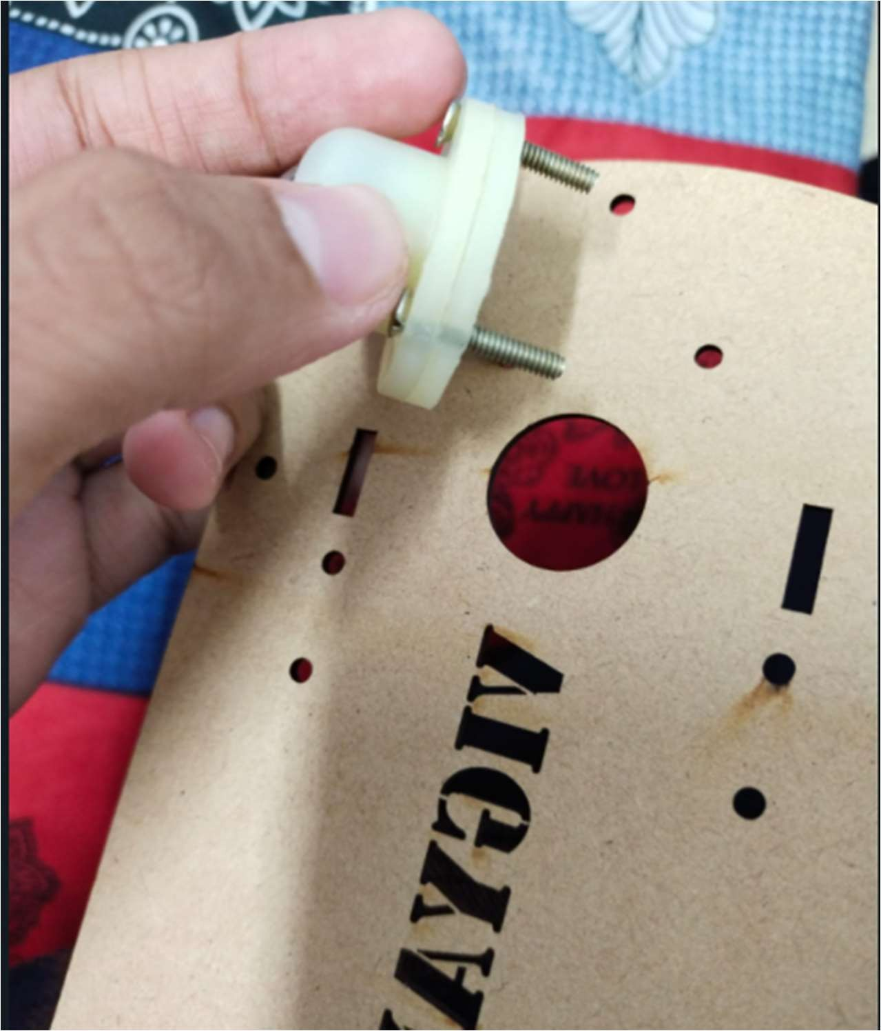
Step 3 : Attach Caster wheel

Slide 6

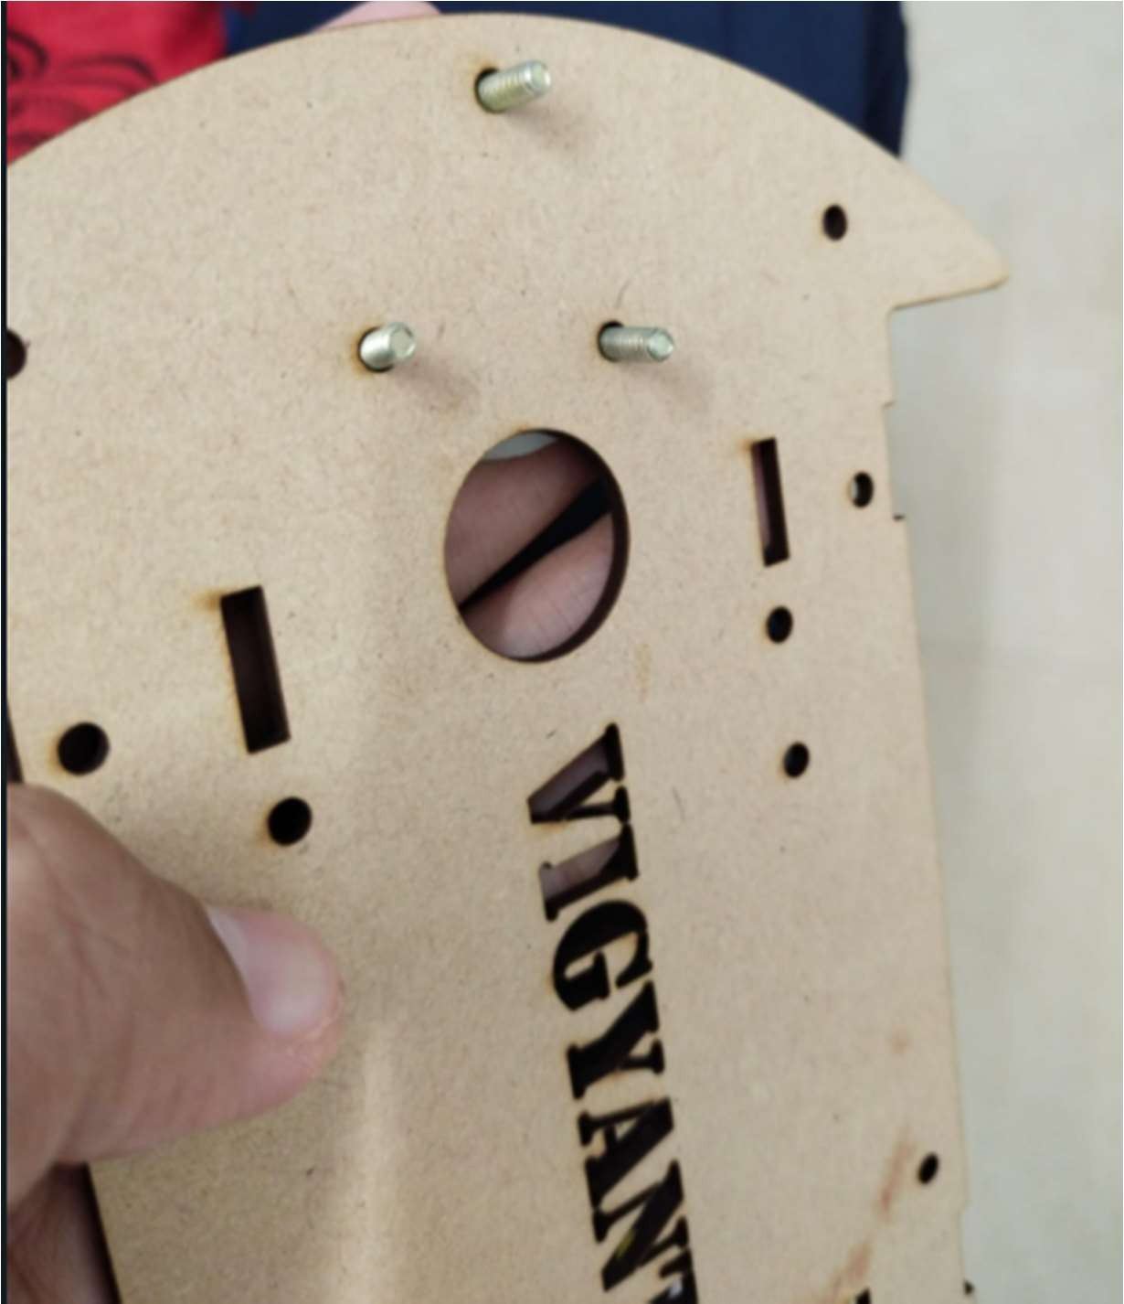
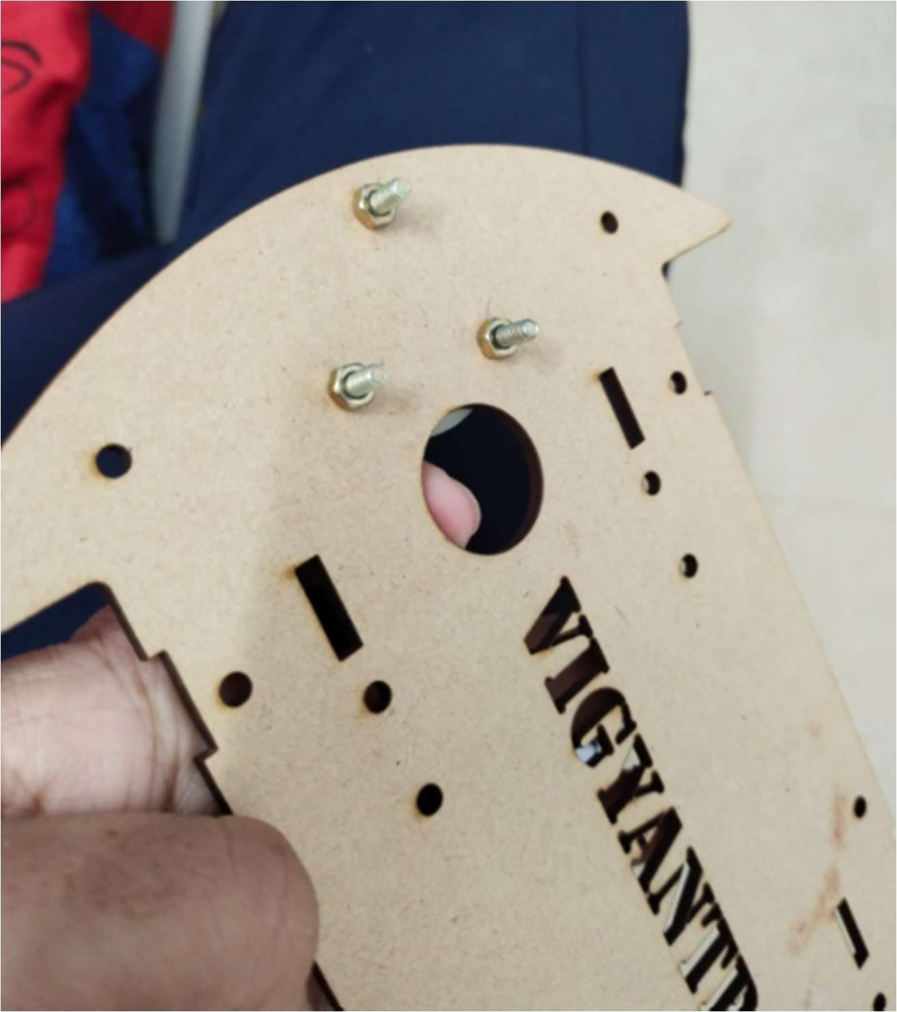
Step 4 : Tight nuts from other side

Slide 7

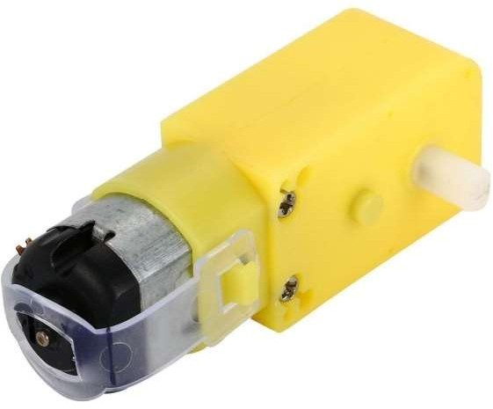
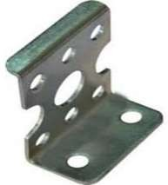
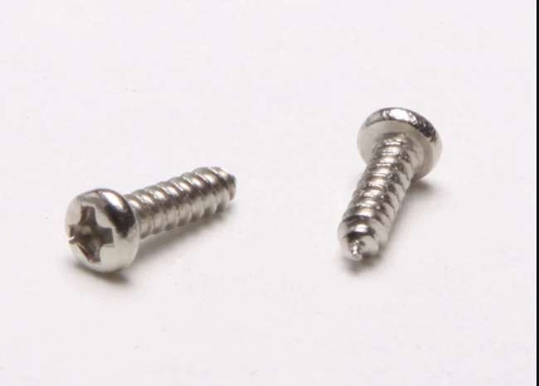
Step 5 : Take out these things
1 Motor
1 Clamp
2 small Silver screws

Slide 8

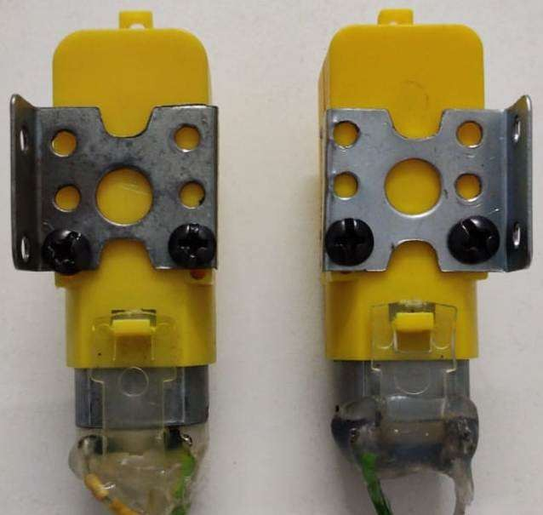
Step 6 : Attach Clamp as shown Below

Slide 9

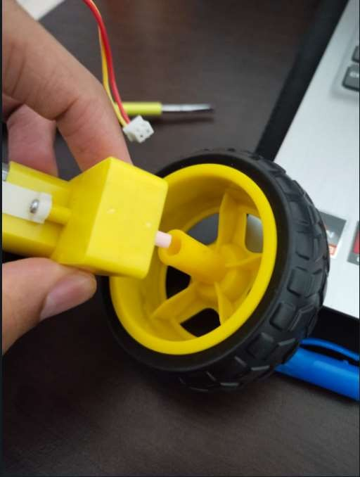
Step 7 : Attach wheel with Motor

Slide 10


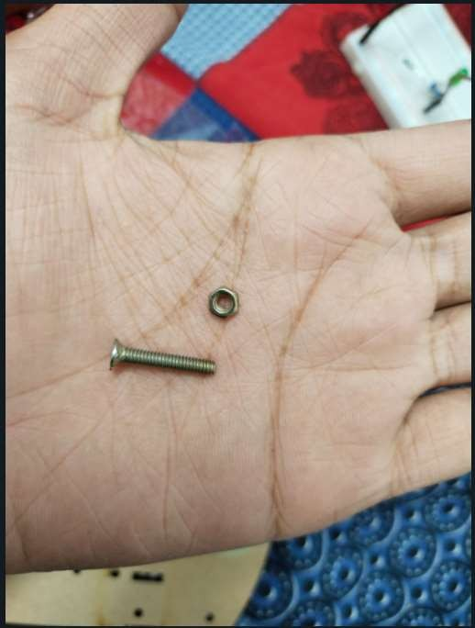
Step 8 : Take out 2 long screw and bolts
2 Golden colour Nut and bolt

Slide 11


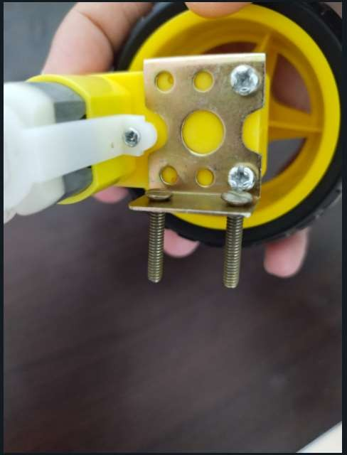
Step 9 : Insert Screws as shown
Insert both long golden nut as Shown

Slide 12

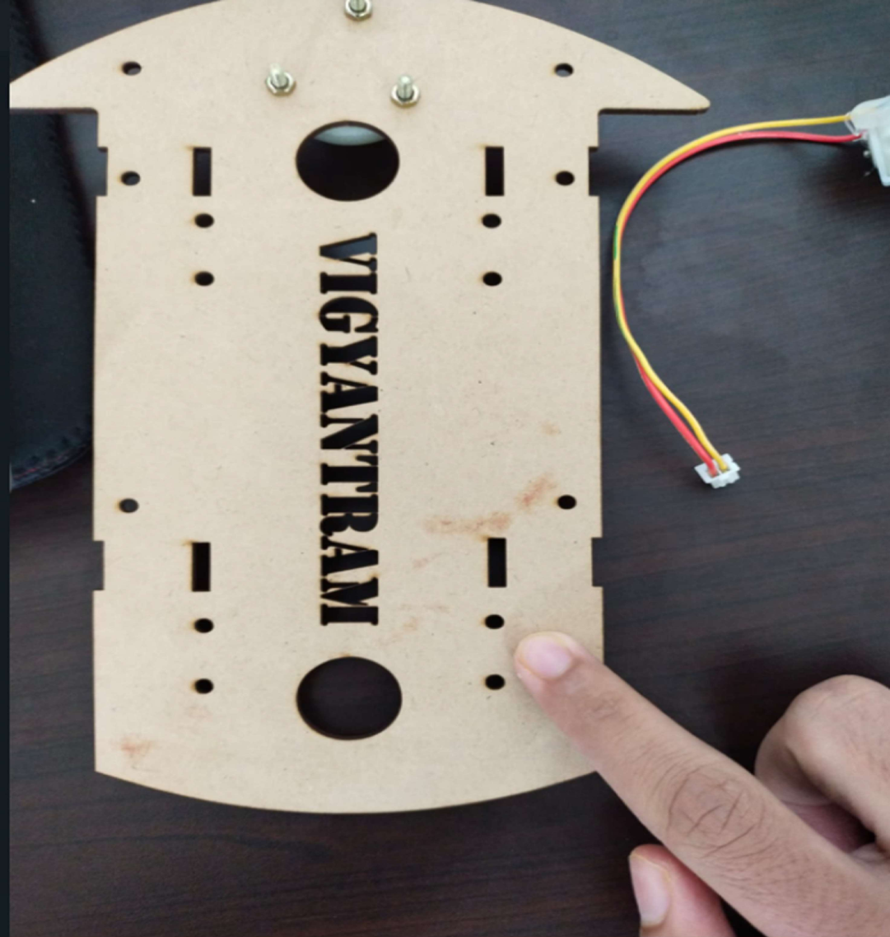
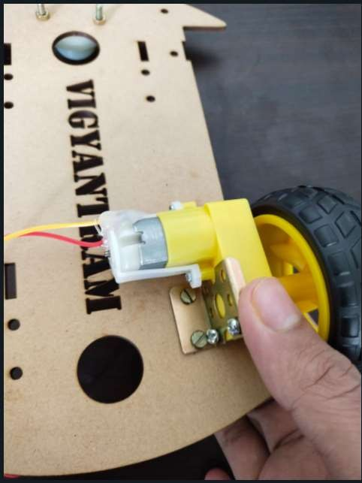
Step 10 : Attach Motor with Cardboard

Slide 13

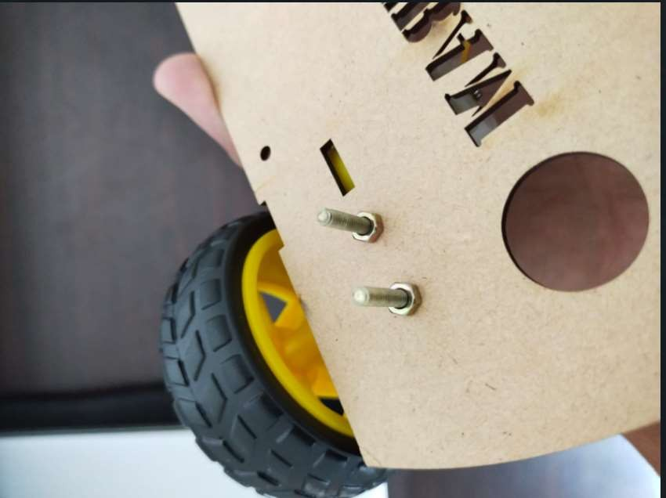
Step 10 : Tight Bolts from backside

Slide 14

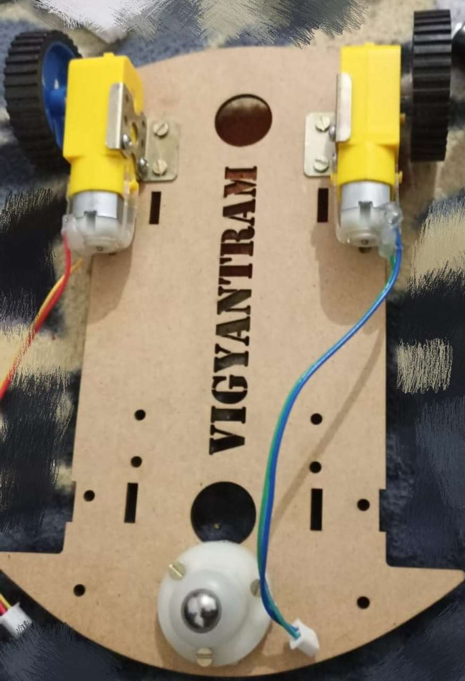
Complete Assembly

Slide 15
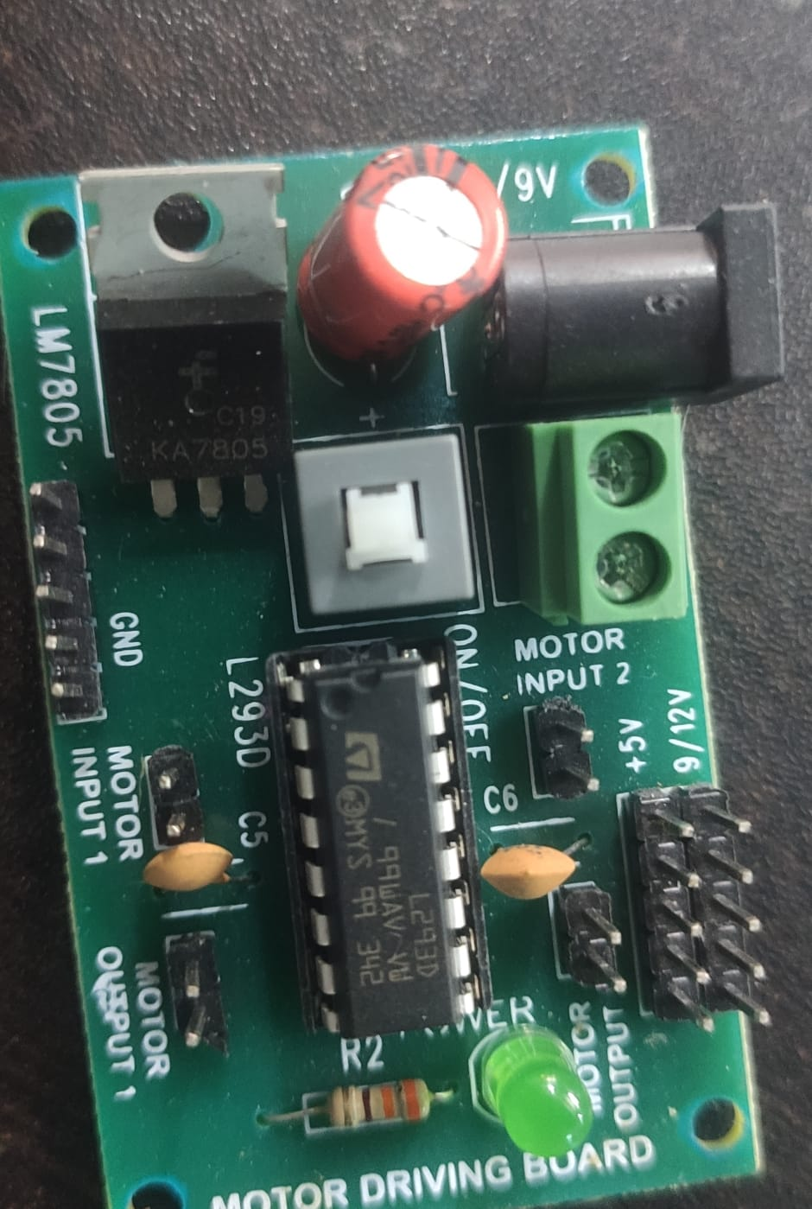
L293 D Motor Driver

Slide 16
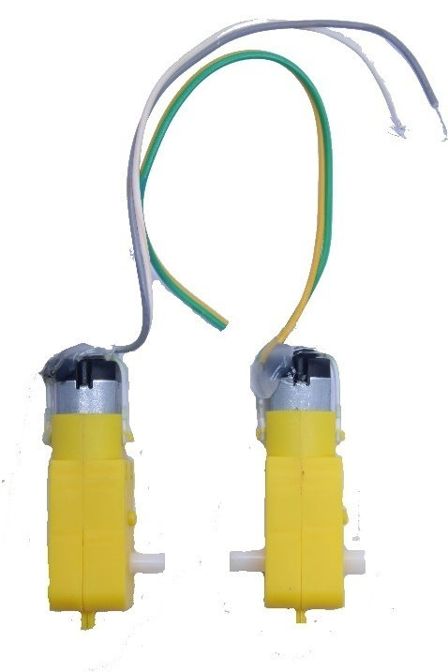
Motor - L293D
Both wire – Motor Output

Slide 17
